Slide 1

Consume data from real stream source and save it to Hbase Big Data Technology Final Project

Slide 2

Submitted To: Prof. Mrudula Mukadam
Final Project (Knowing & Showing Your Hidden Potential to Integrate Parts to Create a Whole)
Submitted By:
Ashish Pokhrel
Saugat Pageni
Brian Onyango

Slide 3
Technologies Used
Hadoop Version 2.7.0
Java JDK & JRE Version 8
Intellij
Kafka Version 2.11-1.1.0
HBase Version 2.2.5
Spark Version 3.2.4

Slide 4
NOTES
Attempted to implement Flume for Twitter data retrieval on Cloudera server.
Encountered issues during the setup on the Cloudera server.
Decided to establish a local message publishing system using Kafka as an alternative.
The goal is to send Twitter data to Kafka topics and process and analysis data and save it to HBASE

Slide 5
Project Overview
Spark Streaming Application Choose a Twitter API and set up developer credentials.
Configure Apache Flume to collect Twitter data in real-time.
Run the Spark Streaming application to process the data received from kafka
HBase Integration Install and configure HBase on cluster.
Modify the Spark Streaming application to save processed data to HBase.
Receive the messages from kafka
Create a Kafka consumer to further process or distribute the data as needed.
Kafka Integration Install and configure Apache Kafka on cluster.
Note: Was having issue in Cloudera VM so configured to setup some dynamic data by own and used those data to be processed. But we have the flume configuration and twitter developer account setup.

Slide 6

Project Big Picture
KAFKA PRODUCER/ KAFKA CONSUMER
FLUME
TWITTER
SPARK STREAMING
HBASE
Notes:
1.First we will get the data from twitter and store it in the Kafka Logs
2.Now from Kafka logs, we will use Spark Streaming to store the data in the HBase tables(Perform some aggregation)
3.Now we will read the data stored in Hbase table and using Spark SQL we will store the it HDFS.
4.Now we will create External Hive table using location where the csv file stored in HDFS
5.Now connect Hive to Tableau and visualize.

Slide 7
Details
Twitter Kafka Producer: Setup 1 application to process twitter message in a topic
We utilized a developer credentials provided by Twitter to access tweets via the API. But was having some issues in cloudera so processed with local kafka producer.
We established a connection to a Kafka topic using kafka consumer and integrating it with spark streaming and tested for the messaged received to this Kafka topic.
We then consumed the message and saved it into the Hbase.

Slide 8
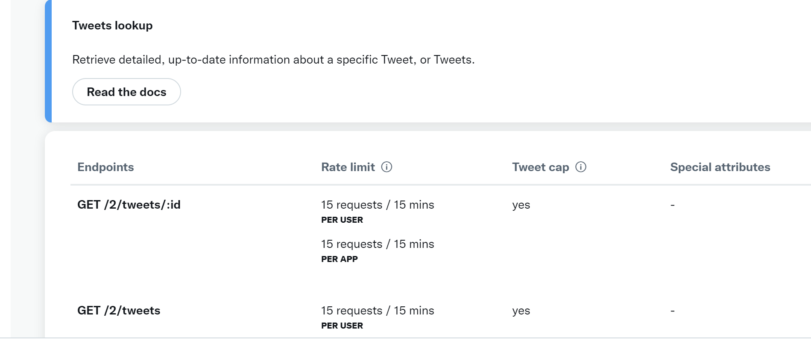
API Used from Twitter

Slide 9
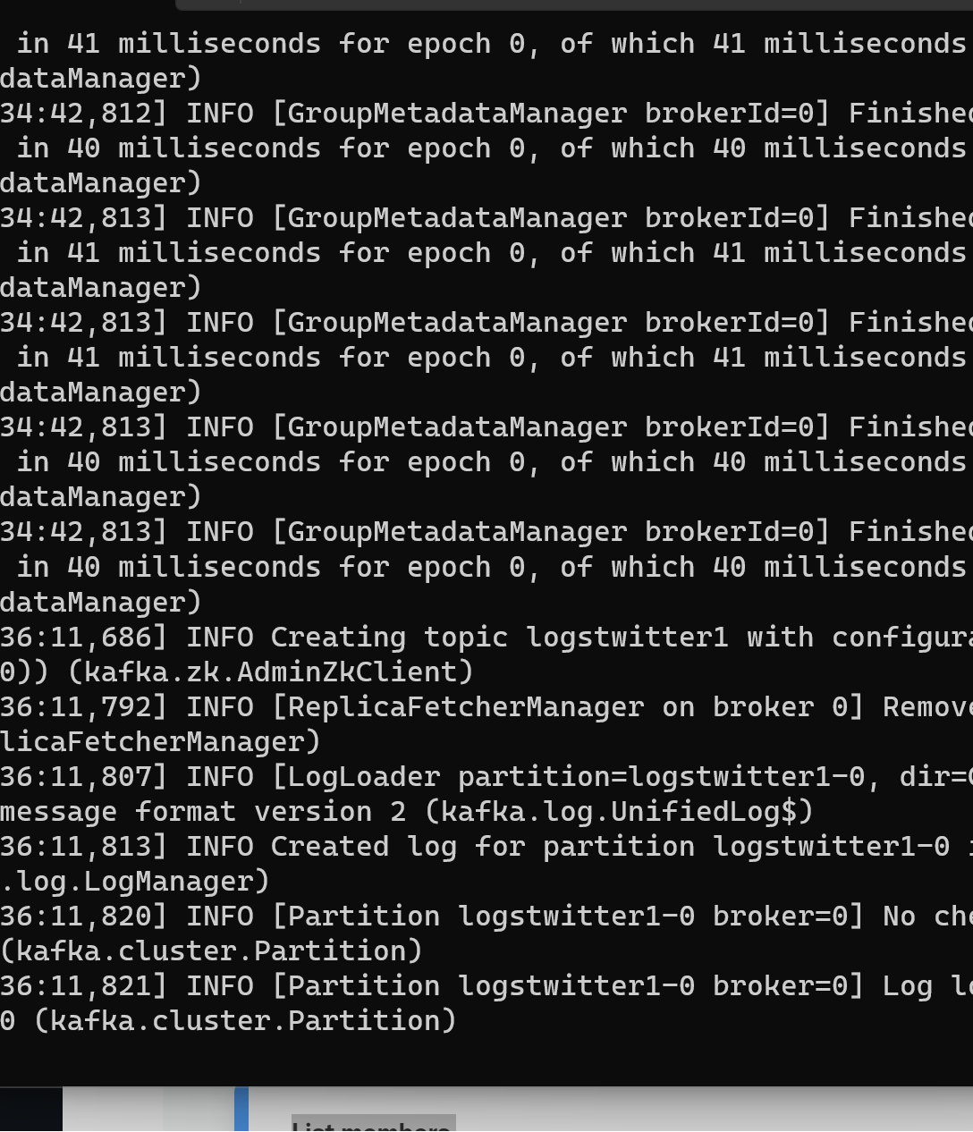
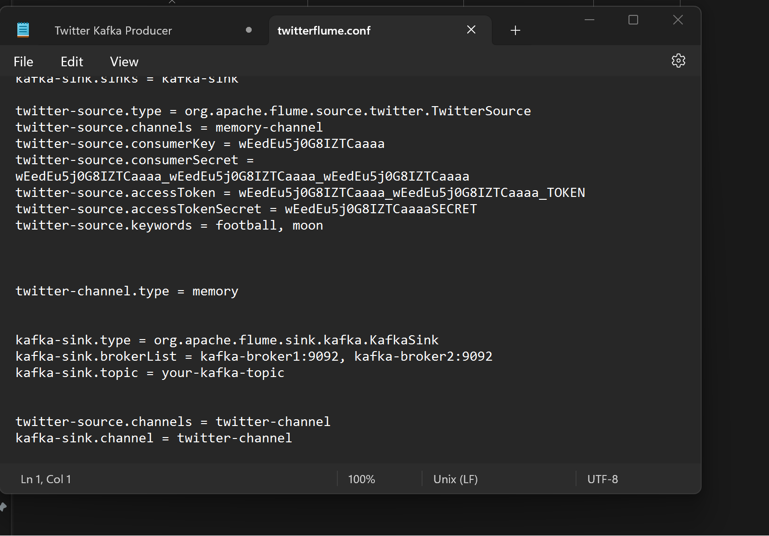
FLUME SOURCE CHANNEL AND SINK Twitter And Kafka

Slide 10
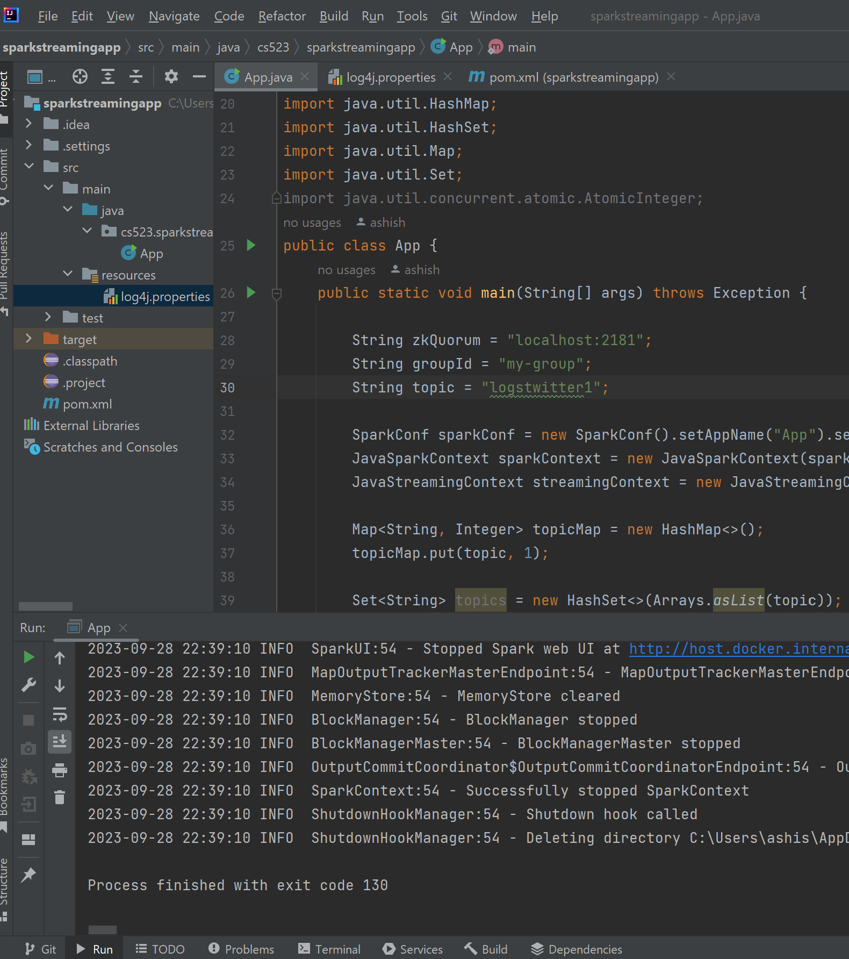
Cont’d…

Slide 11
SPARK-KAFKA-HBASE
Integration Stack: Integrated Apache Spark, Apache Kafka, and Apache HBase to create a data processing pipeline.
Java Code: Developed Java code to orchestrate the entire data flow from Kafka to HBase.
Kafka Data Ingestion: Utilized Kafka Java libraries to ingest real-time data from Kafka topics.
Spark Streaming: Implemented Spark Streaming in Java to process and analyze the incoming Kafka messages in near real-time.
Data Transformation: Wrote Java code within Spark to perform data transformations, filtering, and enrichment as required.
HBase Integration: Integrated Java with HBase using the HBase Java API for seamless data storage.
Data Persistence: Stored processed data efficiently in HBase tables, considering column families and qualifiers.
Fault Tolerance: Ensured fault tolerance within the Java code to handle failures gracefully.

Slide 12

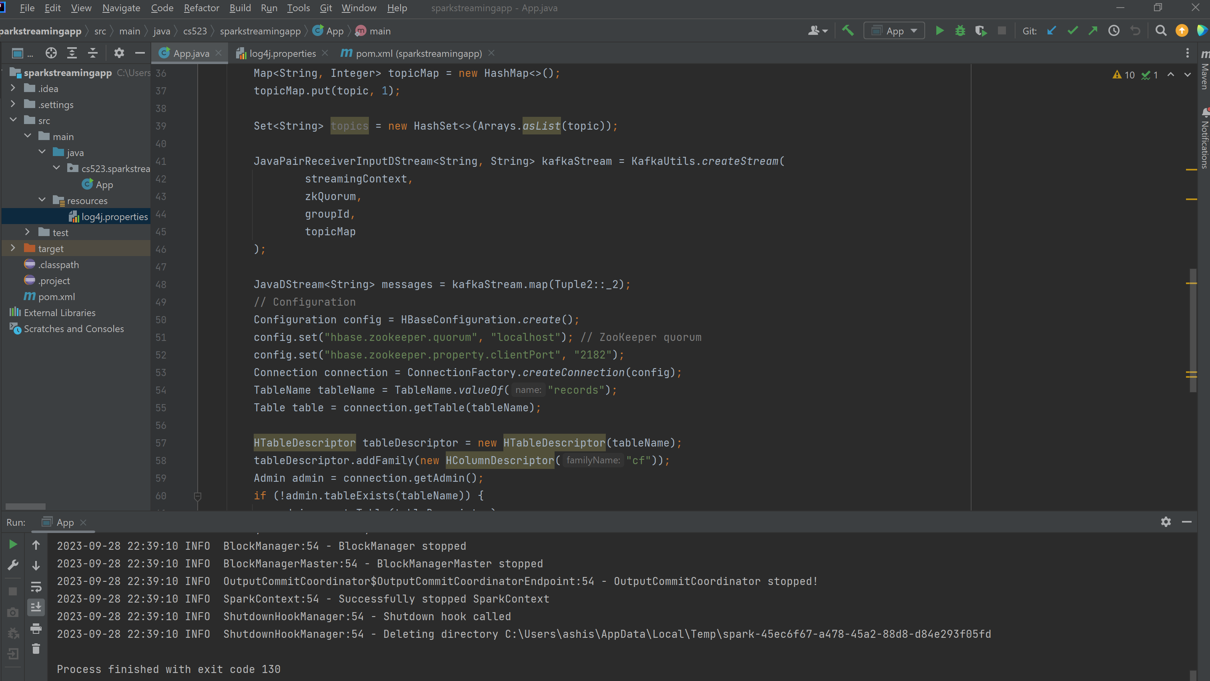
Spark Streaming Kafka topics to HBase

Slide 13
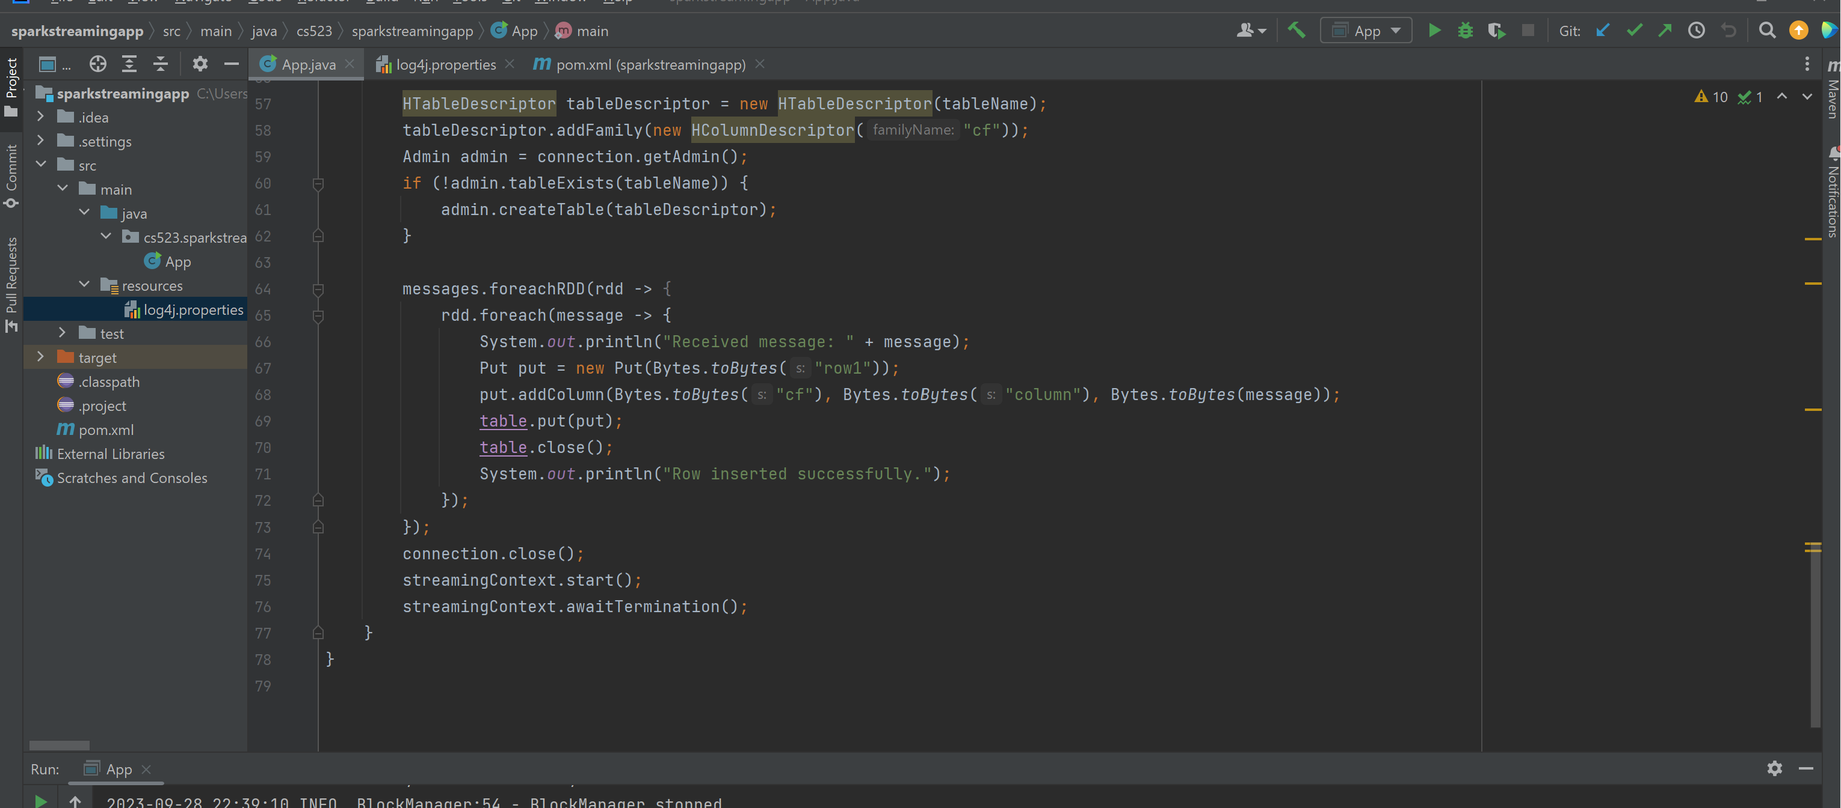
Spark Streaming Kafka topics to HBase Cont’d…

Slide 14
Cont’d

Slide 15
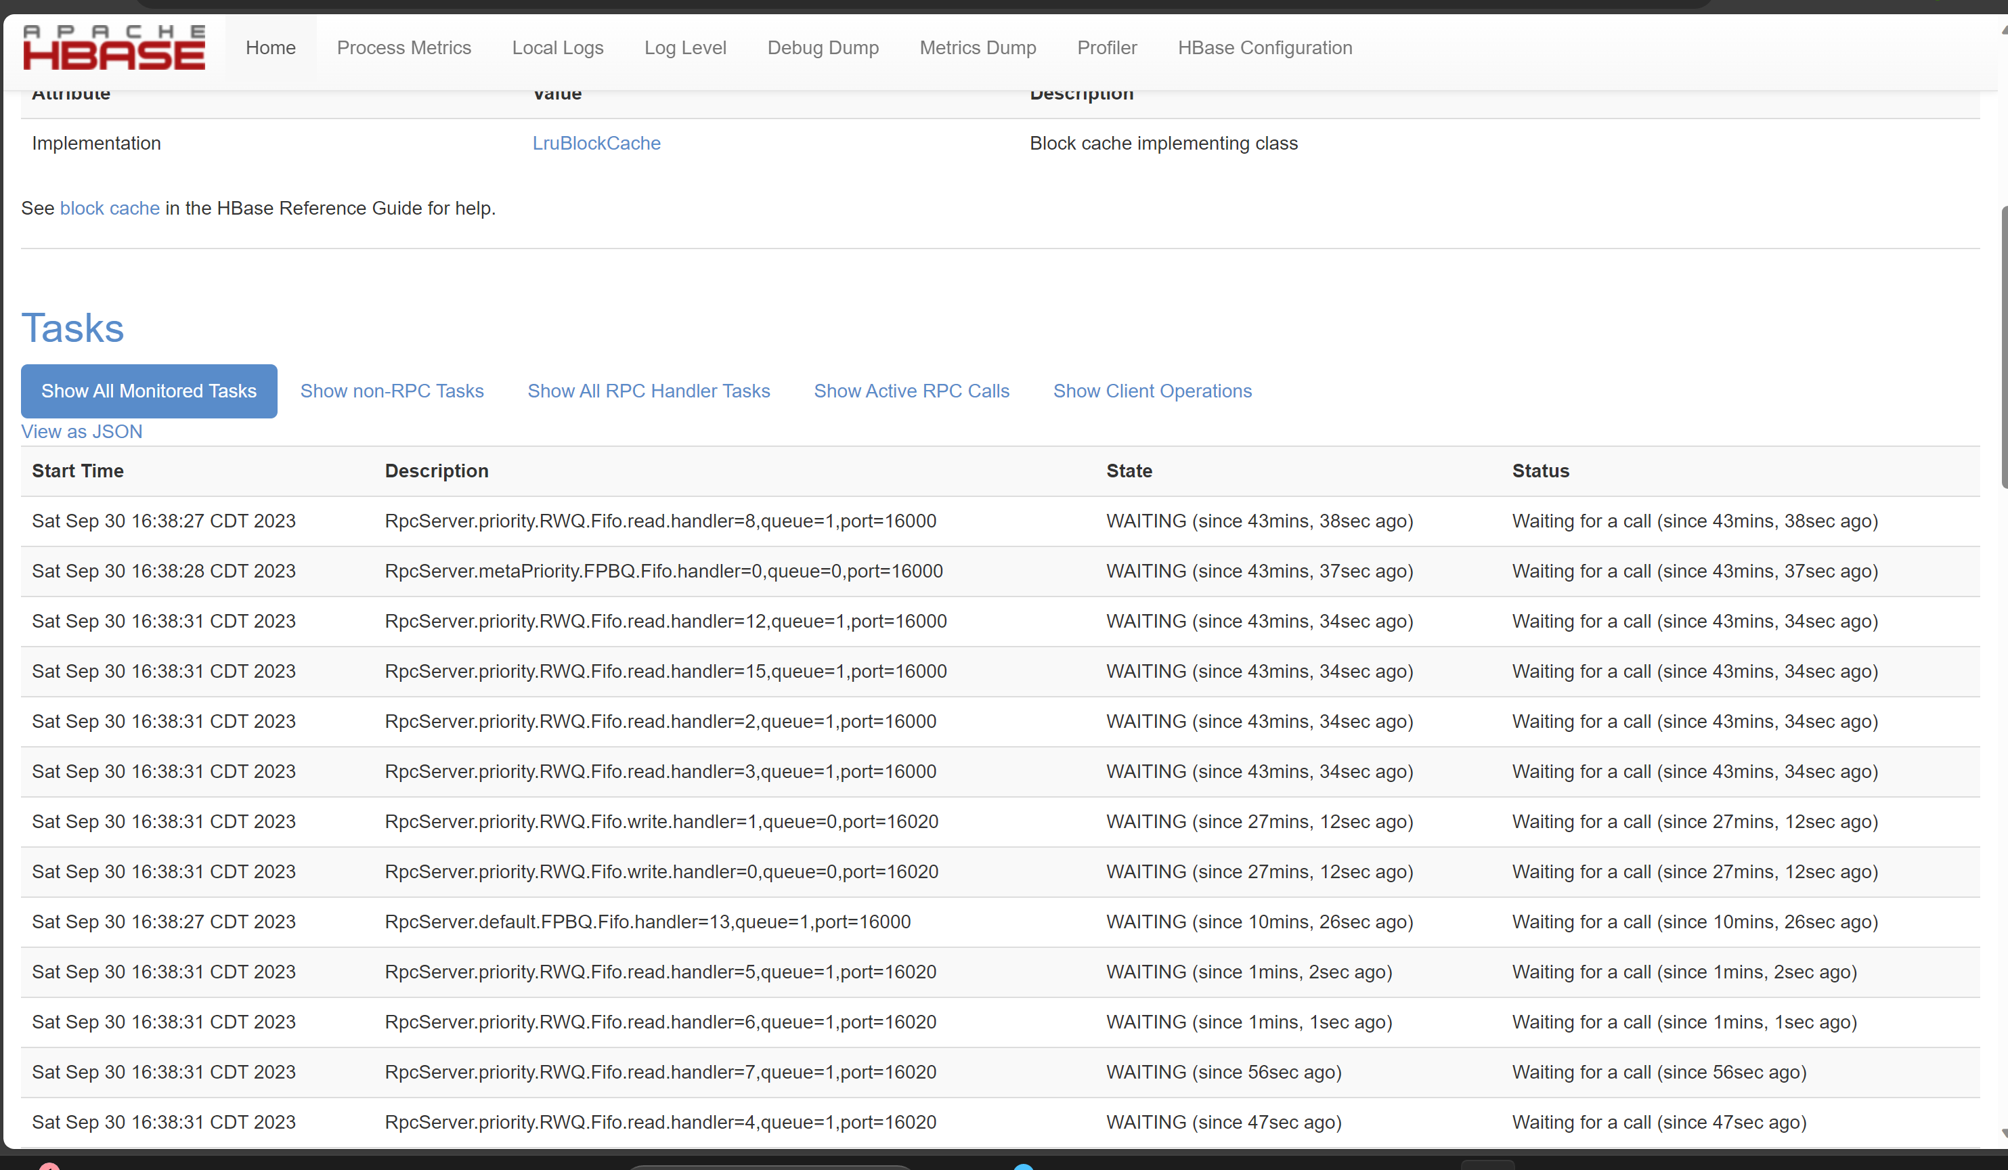
Cont’d

Slide 16
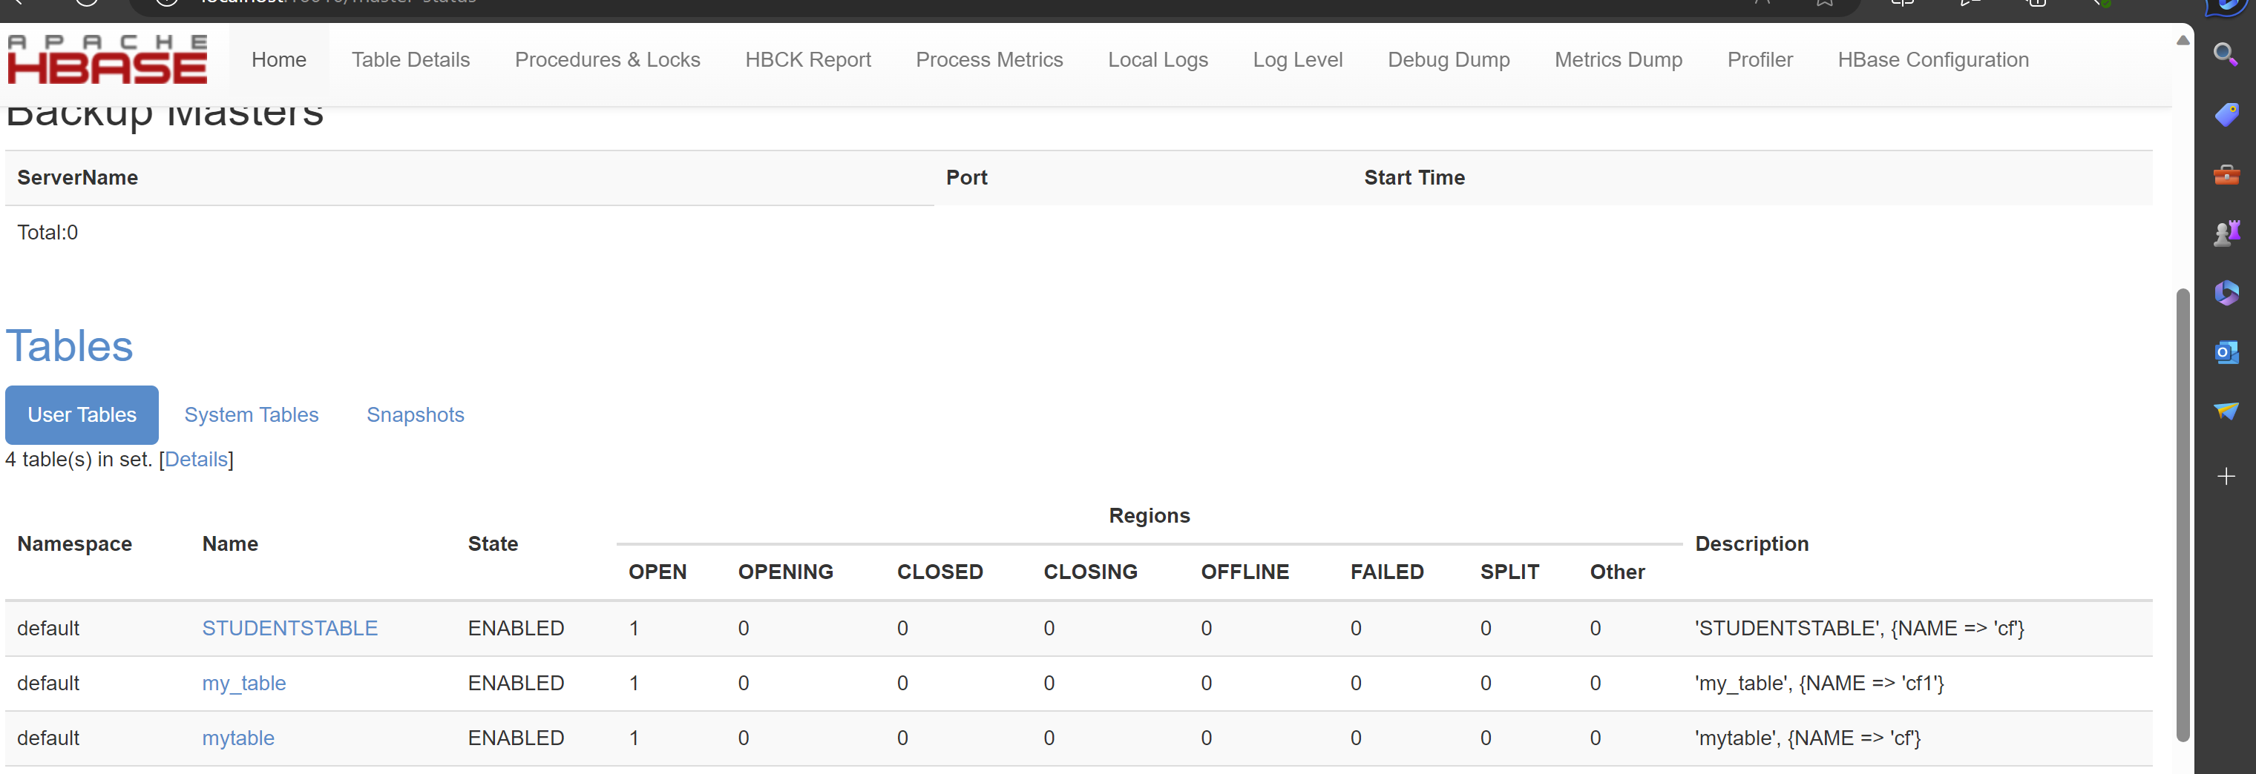
Cont’d

Slide 17
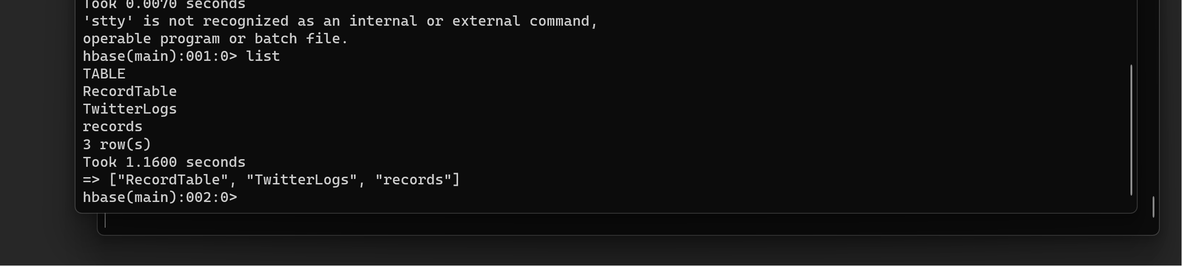
Cont’d

Slide 18
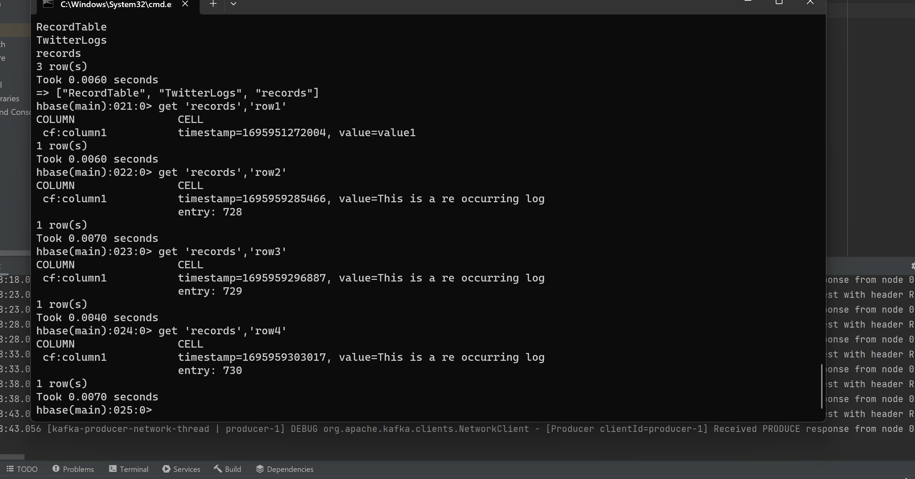
Cont’d

Slide 19
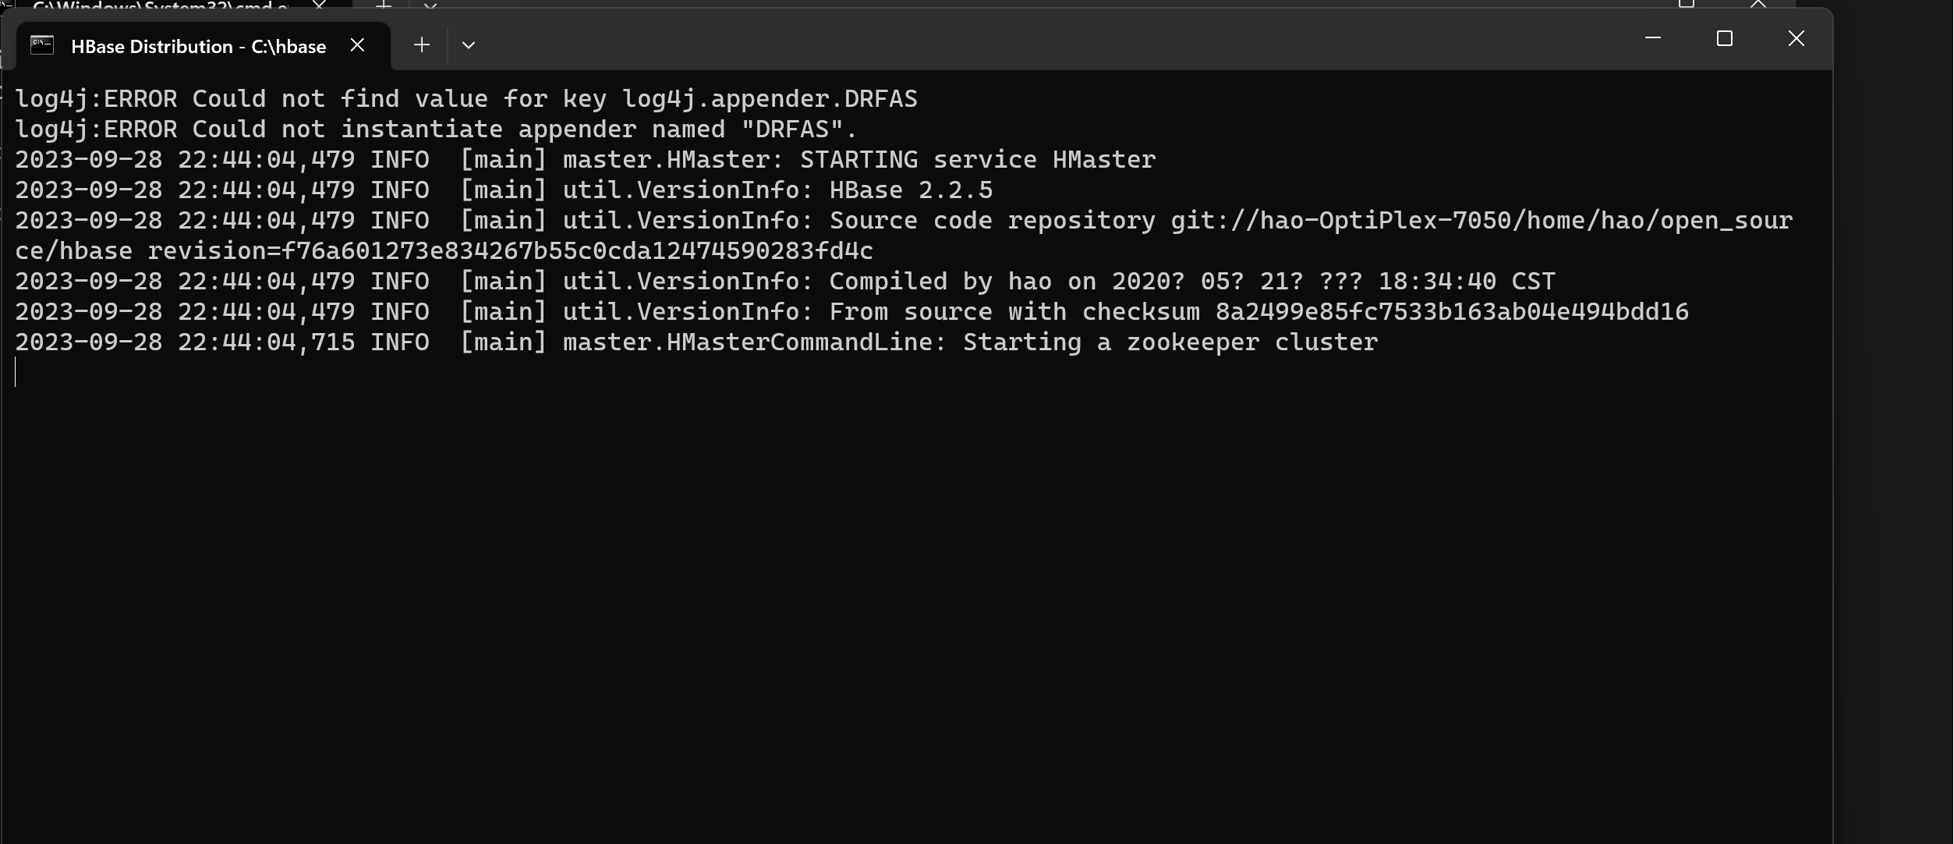
Cont’d

Slide 20
Wholeness of Project
In this project, we've harnessed a range of technologies including Kafka, Spark, HBase, FLUME, among others, to gather tweets from Twitter and conduct insightful analyses.
Additionally, we explore the realm of Consciousness Science and Technology. Our journey involves delving into the layers of creation and uncovering the unified field of consciousness. To achieve this understanding, we engage in a daily practice of Transcendental Meditation. Through this practice, we witness positive transformations in our daily lives, sometimes even finding that nature itself offers its support along the way.
Notes:
Notes:

Slide 21
Any Questions
Notes:
Notes:

Slide 22

THANK YOU,
PROFESSOR Mrudula Mukadam

